Slide 1
G481/581 Terrestrial Ecosystem Modeling Biogeochemistry in TEMs (Carbon, Nutrient Cycles and Disturbance)
Guest lecturer: Dr Kashif Mahmud

Slide 2
Overview
Plant Carbon Cycle
Photosynthesis
Respiration fluxes
Allocation and biomass turnover
Soil carbon models
Nutrient cycles (briefly)
Disturbance (briefly)

Slide 3
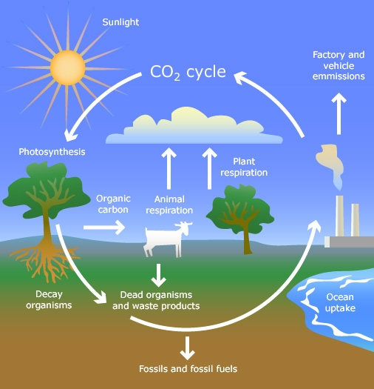
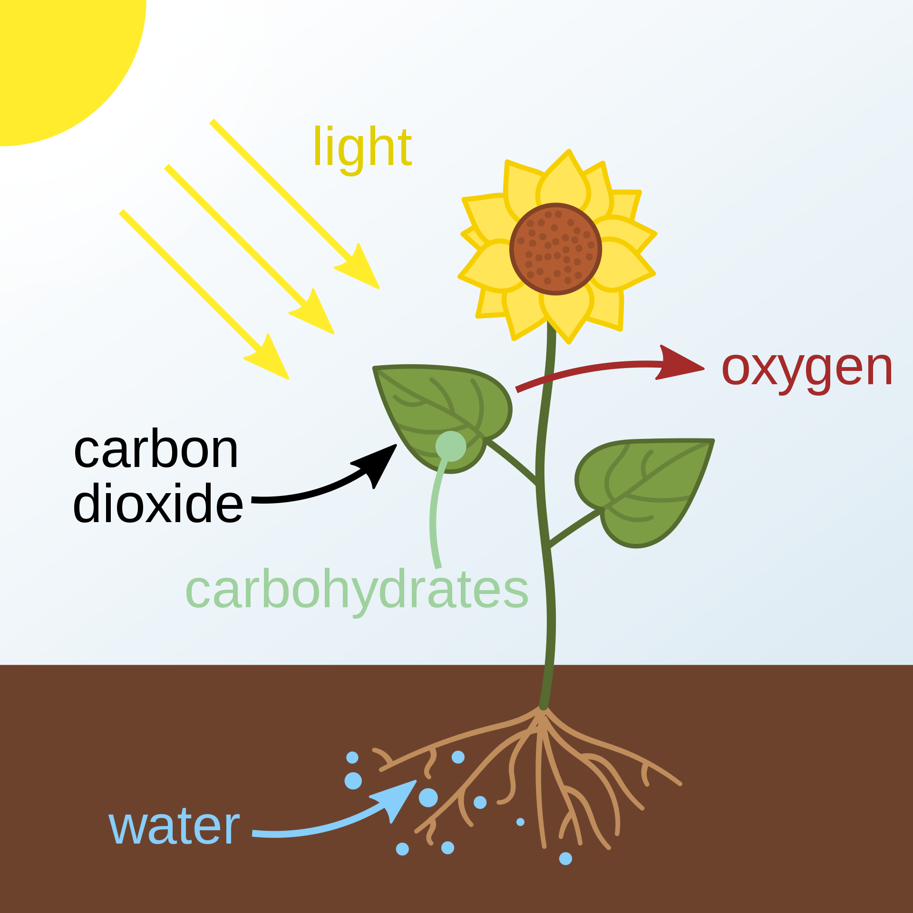
Carbon cycle
Photosynthesis – plants convert light energy into chemical energy
GPP - Gross primary production
Living biomass holds about 550 gigatons of C
Notes:
Carbon cycle is an essential part of life on Earth.
C is mainly stored in both living and dead biomass, where living biomass holds about 550 gigatons of C, most of which is made of terrestrial plants (i.e. wood).
Now zooming into plant C cycle, plants convert light energy into chemical energy (in the form of carbohydrates) with a process called Photosynthesis.
These carbohydrates are used for plants’ activities such as respiration, growth and litterfall.
The total amount of chemical energy that plants generate through photosynthesis is called Gross primary production (GPP).

Slide 4
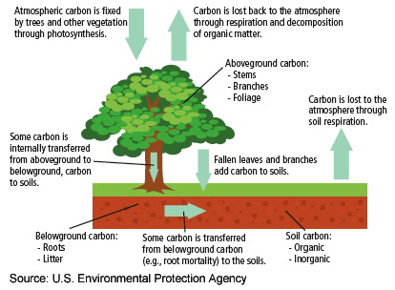
Plant Carbon Cycle
Notes:
Now let’s focus on the entire C cycle related to the plants.
Atmospheric C is fixed by tress and other vegetation through photosynthesis.
A portion of C is lost back to the atmosphere through plant respiration and decomposition of organic matter.
C assimilated by trees is then allocated to leaves, stems, and branches.
A fraction of C is internally transferred from aboveground to belowground to the roots, and then some C is further transferred to soils via litter, root mortality.
The aboveground litterfall, mainly fallen leaves and branches add C to soils.
So the aboveground total C is the entire tree structure that we can see, consists of foliage, stem and branches.
Whereas the belowground C is mainly the roots and some litter.
Soil C has both organic and inorganic components.
Another path of C lost to atmosphere is the soil respiration which refers to the production of carbon dioxide when soil organisms respire. This includes respiration of plant roots, the rhizosphere, microbes etc.

Slide 5
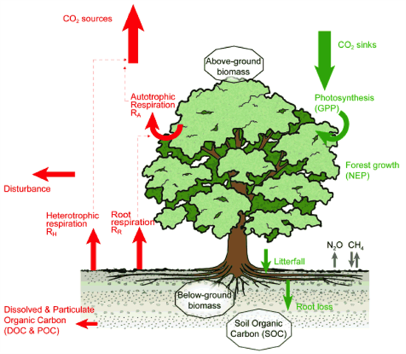
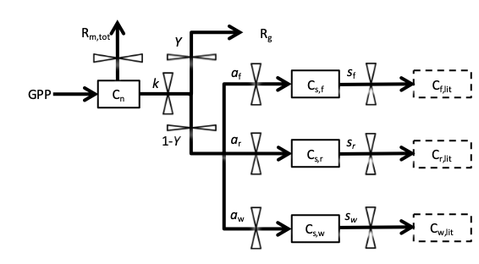
Plant Carbon Cycle
Can be applied to all ecosystems!
Net Primary Production, NPP = GPP – R_{A}
→ Net amount of C assimilated into system and allocated to biomass pools
Net Ecosystem Production,
NEP = GPP – (R_{A}+R_{R}+R_{H} + Disturbance + DOC)
→ Net amount of C into and out of system
GPP = Gross Primary Production
Allocation
Litterfall = turnover of aboveground biomass
Mahmud et al. (2018)
Notes:
Another way of visualizing the same cycle but in terms of incoming (green) and outgoing (red) fluxes as arrows, and stores/C pools in the bubbles.
Allocation is also added in yellow arrows which shows C assimilated via photosynthesis is allocated to plant growth between foliage, stem, branch and roots.
A carbon cycle model is a ”flux and stocks” model in which fluxes of C are modeled between different C pools.
One simple example is here on the left bottom that we have used to model the aboveground biomass and fluxes where the boxes are the C pools and arrows are the fluxes. I’ll talk about this more later today.
The total C sink due to plants is the total GPP via photosynthesis.
A fraction of that GPP is used for plants’ respiration (autotrophic respiration, R_{A}) and the rest is called Net primary production (NPP) which plants actually use for their structural growth.
Then the Net Ecosystem Production, NEP is represented by this equation.
Heterotrophic respiration, R_{H} refers to the carbon lost by organisms in ecosystem other than the plants.
Disturbance includes all sorts of anthropogenic and severe environmental conditions for example deforestation, plant mortality due to fire, drought etc.
Soil organic C has two major components Dissolved and particulate organic C, where DOC is lost from the system via dissolving into water and POC usually remains in the soil.
This is the general form of the C cycle and can be applied to all ecosystems, not only forest, but also other ecosystems like grassland, cropland etc.

Slide 6
General equations
Very similar to calculating the soil moisture flux and storage down soil profile except flux between different C pools and not flux between different soil layers (as in the case with water)
Calculate the fluxes (e.g. C assimilated via photosynthesis) at each timestep
E.g.: F = f(T, W, CO₂, etc)
Update the C pool/store based on the net flux in minus the net flux out
E.g.: dS/dt = F_{in} – F_{out}
→ Generally linear equations and dependencies on environmental variables; therefore, easier to solve!
Notes:
Here's the general equation for the C flux
F = f(T, W, CO2, etc) F is the flux, f() is a “function of”, T temp, W water, CO2, etc.
dS/dt is change in store/C pool at each timestep with flux in minus flux out
Generally linear equations and dependencies on environmental variables; therefore, easier to solve
Just a general description as we’ll get to what’s driving photosynthesis, respiration and soil C fluxes in a bit.

Slide 7
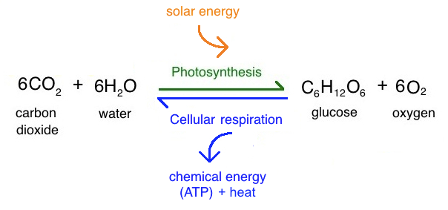
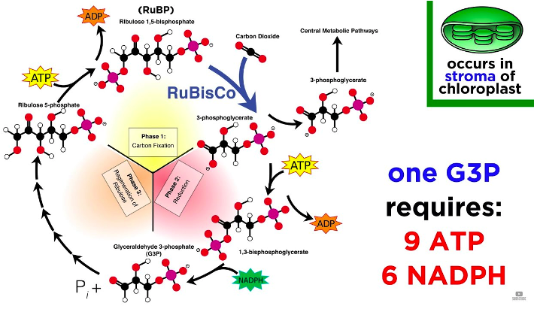
Leaf gas exchange: Photosynthesis and Stomatal Conductance
Photosynthesis: process by which plants take up CO₂ (+ energy from sun and water) to make sugars (biomass)
ATP: Adenosine triphosphate
Calvin Cycle (Calvin-Benson cycle)
RuBisCo: Ribulose-1,5-bisphosphate carboxylase/oxygenase
NADPH: Nicotinamide adenine dinucleotide phosphate
Notes:
Photosynthesis is the process by which plants take up CO2 form air, light energy from sun and water from soil to make sugars as food
The chlorophyll present in leaves of photosynthetic plants captures energy from sunlight and converts it to carbohydrates.
The overall chemical reaction behind photosynthesis can be written as “6H2O + 6CO2 -----> C6H12O6+ 6O2.”
Photosynthesis uses carbon dioxide (CO2) and water as raw material to produce sugar and release oxygen as a byproduct.
The opposite direction of this equation is called respiration, releasing additional ATP and heat as biproducts.
The photosynthesis occurs in two stages. The first stage is the reaction of light used to form high energy molecules. The energy harvested in the light reaction is stored in cells in the form of a chemical named as ATP, or adenosine triphosphate.
The second stage of photosynthesis is called the Calvin Cycle Reaction. In this part of the reaction, chemical energy stored at ATP is used to produce sugar from CO2 through enzyme reactions.
Initially, CO2 reacts with a five-carbon compound called, ribulose bisphosphate (RuBP), catalyzed by the enzyme RuBisCo to produce a stable, three-carbon compound called as phosphoglycerate (PGA). Energy captured in ATP converts PGA into glyceraldehyde 3-phosphate (G3P) which is converted to other organic compounds.
Photosynthesis is highly determined by the factors such as light intensity, soil nutrients, water availability, temperature and concentration of carbon dioxide in the atmosphere.

Slide 8
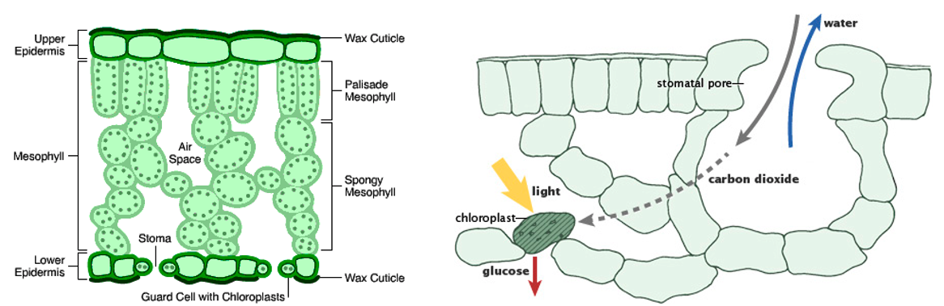
Leaf gas exchange: Photosynthesis and Stomatal Conductance
CO₂ enters via stomata (pores in leaves); H₂0 also lost via stomata during transpiration (as we saw → strongly related to stomatal conductance)
Notes:
Now looking at the biological concept of Photosynthesis which takes place primarily in leaves.
The typical leaf includes the upper and lower epidermis, mesophyll and stomate, or plant pores.
The upper and the lower epidermis serve as a protection to the leaf.
The stomates are pores in the lower epidermis that act as a passage for air and water to pass.
The mesophyll contains chloroplast where photosynthesis occurs.
CO₂ enters via stomata (pores in leaves); H₂0 also lost via stomata during transpiration (as we saw → strongly related to stomatal conductance)
Stomatal conductance can be a good indicator of plant water stress
Many plants regulate water loss via stomatal conductance, which means in water stress condition stomata close down to save water loss which in turn reduces CO2 access through the stomata and as a result reduces photosynthesis.

Slide 9
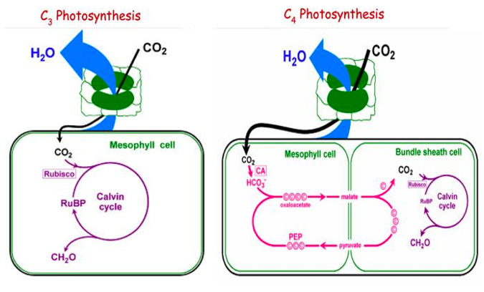
Photosynthesis C3 vs C4
C3 photosynthesis: photosynthetic pathway used by most plants
Uses enzyme Rubisco to fix CO₂ from air
As temperature increases, Rubisco fixes more O₂ than CO2 (photorespiration) → loss of CO₂
C4 photosynthesis: evolved more recently (especially in drier climates)
Plants adapted to inefficiency of C3 photosynthesis in hotter climates
Developed a mechanism to more efficiently deliver CO2 to Rubisco enzyme
Notes:
C3 photosynthesis is the photosynthetic pathway used by most plants, roughly 85 percent of the plants on earth utilize C3 photosynthesis.
C3 photosynthesis uses enzyme Rubisco to fix CO2 from air. As temperature increases, Rubisco fixes more O2 than CO2 (photorespiration) and hence loss of CO2 occurs
Photosynthetic organisms that undergo C3 photosynthesis begin the process of energy conversion, known as the Calvin cycle, by producing a three-carbon compound called G3P. This is the reason for the title "C3."
C3 photosynthesis is a one-stage process that takes place inside of the chloroplast, which act as storage centers for sunlight energy. The plant uses that energy to combine ATP and NADPH to produce sugar molecules as we have seen before.
C4 photosynthesis evolved more recently (especially in drier climates), where Plants try to adapt to inefficiency of C3 photosynthesis in hotter climates
Developed a mechanism to more efficiently deliver CO2 to Rubisco enzyme, which we can see on the right-side diagram
C4 photosynthesis is a two-stage process that produces a four-carbon intermediate compound. This process occurs in the chloroplast of a thin-walled mesophyll cell.
Once created, the plant pumps the intermediate compound into a thick-walled bundle sheath cell, where it splits the compound into carbon dioxide and a three-carbon compound.
The carbon dioxide then undergoes the Calvin cycle, as in C3 photosynthesis.
The benefit of C4 photosynthesis is that it produces a higher concentration of carbon, making C4 organisms more adept at surviving in habitats with low light and water.

Slide 10
Photosynthesis and stomatal conductance in TEMs*
Very common C3 photosynthesis model used in vast majority of TEMs:
Farquhar et al. (1980) and Farquhar and von Caemmerer (1982)
Set of equations that summarize the set of reactions that occur in photosynthesis (Calvin cycle)
Common C4 photosynthesis model: Collatz et al. (1992)
Most models then assume strong relationship between stomatal conductance (which is also used to calculate transpiration) and net CO₂ assimilation rate (per unit leaf area) from photosynthesis:
Most common is the Ball - Berry model (Ball et al., 1987) → based on empirical data
More recent versions based on theoretical optimality approaches (e.g. Medlyn et al., 2011) → plants should act to minimize amount of water loss per unit of C gained
Some parameters of these model are not well known
Models differ on which photosynthesis and stomatal conductance models they use
→ The way in which TEMs implement equations of all models differs
Notes:
Won’t go into more detail here as it’s complicated, but someone who loves math and not scared of equations is welcome to dig into more detail on Photosynthesis and stomatal conductance in TEMs for their project
Very common C3 photosynthesis model used in vast majority of TEMs are Farquhar et al. (1980) and Farquhar and von Caemmerer (1982)
These two papers describe the set of equations that summarize the set of reactions happening in photosynthesis Calvin cycle.
Common C4 photosynthesis model used in TEMs is Collatz et al. (1992)
Most models then assume strong relationship between stomatal conductance (which is also used to calculate transpiration) and net CO₂ assimilation rate (per unit leaf area) from photosynthesis:
Most common is the Ball - Berry model (Ball et al., 1987) → based on empirical data
More recent versions based on theoretical optimality approaches (e.g. Medlyn et al., 2011) → plants should act to minimize amount of water lost per unit of C gained
Now few limitations about these models are: Some parameters of these model are not well known
Models differ on which photosynthesis and stomatal conductance models they use
The way in which models implement equations of all models differs

Slide 11
Autotrophic (leaf) respiration
Sum of:
Maintenance respiration (cost of maintaining existing plant tissues)
Growth respiration (cost of growing new tissues)
Some models make very simple assumption that Ra is a simple proportion (e.g. 50%) of C assimilated from photosynthesis (based on empirical data)
Slightly more complicated:
Maintenance respiration “base rate” modified by increases with higher temperature and biomass or higher carbon/nitrogen ratios
Growth respiration is a simple proportion (e.g. 25-30%) of C assimilated from photosynthesis
→ Exact form of these modifying factors differs between models
Notes:
Autotrophic respiration is the sum of Maintenance respiration (which is the cost of maintaining existing plant tissues) and Growth respiration (cost of growing new tissues)
Autotrophic respiration, majority of the time in TEMs represents as leaf respiration because wood respiration rate is far lower than leaf and can be ignored for simplicity
Some models make very simple assumption that Ra is a simple proportion (e.g. 50%) of C assimilated from photosynthesis (based on empirical data)
This fraction can vary approximately between 25 to 60% depending on the plant species
Slightly more complicated models use Maintenance respiration “base rate” modified by increases with higher temperature and biomass or higher carbon/nitrogen ratios
Growth respiration is a simple proportion (e.g. 25%) of C assimilated from photosynthesis
Exact form of these modifying factors differs between models

Slide 12
Allocation within one individual plant
Allocation of NPP to biomass pools: leaves, stem, branches, roots
→ More complex in most models: dead and live stem, coarse and fine roots, fruits, and a carbohydrate reserve or storage pool
Four types of models:
Fixed coefficients: Allocation ratios (e.g. fraction of NPP to leaves compared to roots) are fixed and PFT-dependent → don’t get unrealistic looking trees!
Resource limitations: Allocation ratios are dynamic. PFT-dependent allocation ratio that can be modified based on environmental conditions that affect C allocation, e.g. water limitation, light availability, nutrient limitation. Empirical relationships → parameters not easily measurable and have to be fitted to data
Functional relationships: Allocation based on structural relationships between plant components. Based on hypotheses such as (a) sapwood area must be enough to support plant growth; (b) fine roots must be enough to support water uptake; (c) root activity must balance leaf activity, etc.
Optimality theory: plants will optimize their allocation to maximize carbon gain (and minimize water loss) → changes as environmental conditions change.
De Kauwe et al. (2014)
Notes:
Allocation of NPP to aboveground and belowground biomass pools: leaves, stem, branches, roots
This is more complex in most models: having dead and live stem, coarse and fine roots, fruits, and a carbohydrate reserve or storage pool
This De Kauwe paper gives a great overview of the models. Can also read in Bonan textbook.
The first one is the simplest one with Fixed coefficients: Allocation ratios (e.g. fraction of NPP to leaves compared to roots) is fixed and PFT-dependent → don’t get unrealistic looking trees!
The second one is based on Resource limitations: Allocation ratios are dynamic. PFT-dependent allocation ratio that can be modified based on environmental conditions that affect C allocation, e.g. water limitation, light availability, nutrient limitation. Empirical relationships → parameters not easily measurable and have to be fit to data
Whichever resource is limiting or growth conditions are sub-optimal and plants will grow more of that. E.g. if need more nutrients/water then grow more roots; if there’s an open canopy and more photosynthesis would be beneficial then grow more leaves; if it’s a closed canopy, there would be no benefit to growing more leaves then maybe allocate more to stems, etc.
Functional relationships: Allocation based on structural relationships between plant components. Based on hypotheses such as (a) sapwood area must be enough to support plant growth; (b) fine roots must be enough to support water uptake; (c) root activity must balance leaf activity, etc.
I.e. can’t have representation of a plant that is unrealistic for the physiology
Optimality theory: plants will optimize their allocation to maximize carbon gain (and minimize water loss) → changes as environmental conditions change.
E.g. Balance light acquisition (grow more leaves); Balance water transport or structural support (grow more stem); Balance water/nutrient uptake (grow more roots). Similar to model 2 but there’s some measure of plant performance that’s always being evaluated with every time step.

Slide 13
Allocation to storage pool
Many models have an additional carbohydrate reserve/storage pool
Used for:
Times of stress
New leaf growth at start of season
Different rules for how much C is allocated to this pool (and not used directly for growth of biomass pools), e.g.:
Excess photosynthesis if maximum leaf area reached
No limiting conditions and allocation ratios met
Notes:
Many models have an additional carbohydrate reserve/storage pool which is used for: Times of stress and New leaf growth at start of season
Different rules for how much C is allocated to this pool (and not used directly for growth of biomass pools), e.g.: Excess photosynthesis if maximum leaf area reached, No limiting conditions and allocation ratios met
This storage pool can be modeled based on C balance between all the aboveground C pools.

Slide 14
Plant C cycle model
Parameters:
k – storage utilization rate
Y – growth respiration coefficient
a_{f}, a_{w}, a_{r} – allocations to foliage, wood, roots
s_{f}, s_{w}, s_{r}– turnover rates
Mahmud et al. (2018)
Notes:
Here’s a schematic that we have used to model the storage pool as well as the allocations.
We tried to investigate all plant physiological processes that might affect the growth, by using experimental data and a DA-modelling framework with a simple C balance model.
The boxes are the C pools and arrows represent the C fluxes/flows between various pools and we ran this model in daily time step
The model is driven by daily input of gross primary production (GPP), which directly enters into a non-structural C pool (C_{n}), which represents as the storage pool.
The daily total maintenance respiration, R_{m,tot}, is subtracted from C_{n} pool. This is needed to maintain the plant in a healthy living state.
The pool is then utilized for growth at a rate k (i.e. kC_{n}).
Of the utilization flux, a fraction Y is used in growth respiration (R_{g}), which is the other component of respiration and associated with plant growth.
And the remaining fraction (1-Y) is allocated to structural C pools (C_{s}): among foliage, wood and root (C_{s,f}, C_{s,w}, C_{s,r}).
There will be turn over rates for all the C pools to account for plant litter.
The parameters associated with the model are the C fluxes/flows i.e. utilisation rate, growth respiration, allocations, and turnover rates.

Slide 15
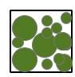
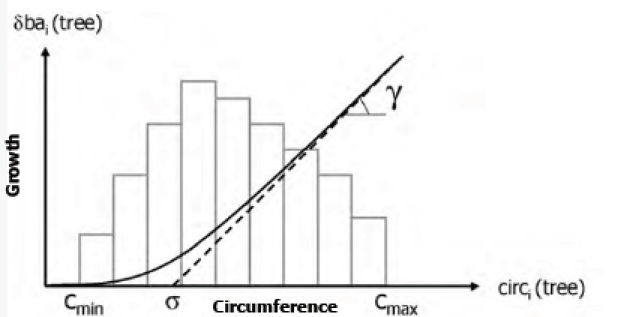
Allocation at stand scale
If we have a gap model (rather than “big leaf”):
calculate photosynthesis per grid cell (e.g. climate forcing given per grid cell)
therefore, model needs to allocate net C uptake to different individuals before it can think about allocation between different biomass pools
Gap models coupled to complex biogeochemistry models are new → modelers still considering how to approach this.
One method based on Deleuze et al. (2004 – on right): allocate most C to bigger individuals (competition)
Notes:
In last week, you have seen mainly two types of stand scale model scenario, the simple one is the big leaf model and another one is slightly complicated one gap model.
If we use a gap model (rather than “big leaf”): first we need to calculate photosynthesis per grid cell (e.g. climate forcing given per grid cell)
Therefore, model needs to allocate net C uptake to different individuals before it can think about allocation between different biomass pools
Gap models coupled to complex biogeochemistry models are new, modelers still considering how to approach this.
One method based on Deleuze et al. (2004 – on right): allocate most C to bigger individuals (which is called as competition between various individual trees)
Deleuze method shown in the plot, as the circumference of the tree canopy goes up, so does the C allocated for growth

Slide 16
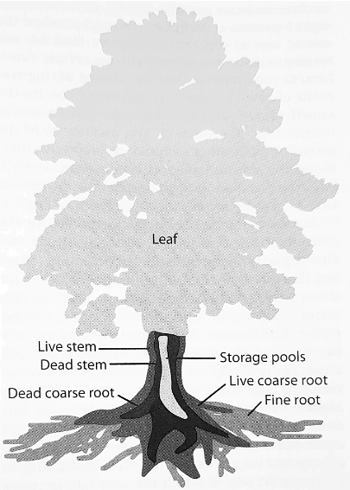
Total aboveground biomass
Sum of incremental addition of net C fluxes in and out of all these C pools
Fluxes calculated at 30 min timestep and summed to day
Allocation calculated per day
Change in biomass pools therefore calculated per day
Notes:
The figure shows the representation of C pools among leaf, stem (live and dead), coarse roots (live and dead), fine roots and storage pool
The black ones are dead, dark grey means live, light grey shows the fine roots and foliage, whereas white stands for mobile storage pool that can freely move from foliage to root via stem as needed
From models perspective total plant biomass would be the sum of incremental addition of net C fluxes in and out of all these C pools
The main steps would be starting from Fluxes calculated at 30 min timestep and summed to day
Allocation calculated per day
And finally the model gives us the Change in biomass pools calculated per day which represents plant biomass growth

Slide 17
Biomass turnover
When leaves senesce or woody mortality occurs → get dead biomass on canopy floor → production of litter
In most models, the “turnover rate” is a PFT-specific parameter for each biomass pool (aside from deciduous phenology schemes resulting in leaf fall each year)
Woody turnover rates include an estimate of “background” tree mortality
Turnover rate = 1 / residence time
Typical residence times:
Leaves: <= 1 year deciduous; 1-3 years evergreen
Roots: 10-20 years
Wood: 40-80 years
→ Very simplistic – parameters based on meta-analyses of field studies
Notes:
When leaves senesce or woody mortality occurs, we get the dead biomass on canopy floor which produces plant litter
In most models, the “turnover rate” is a PFT-specific parameter for each biomass pool (aside from deciduous phenology schemes resulting in leaf fall each year during autumn)
Woody turnover rates include an estimate of “background” tree mortality
Turnover rate = 1 / residence time
Residence time measures how long a plant organ remains within the plant
Typical residence times are:
Leaves: <= 1 year deciduous; 1-3 years evergreen
Roots: 10-20 years
Wood: 40-80 years
These turnover rates are Very simplistic and actually based on meta-analyses of field studies

Slide 18
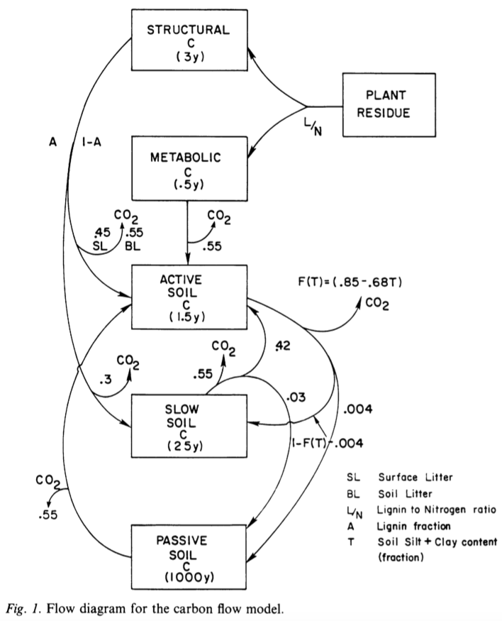
Soil Carbon Cycling
In many TEMs, soil C cycle is based on the CENTURY model (Parton et al., 1987; 1988; 1992; 1993).
Models carbon decomposition by microbes (and release of CO2 when microbes respire)
Therefore, transfer of C between different C pools with different residence times (and release of CO₂ at same time)
Litter broken down into structural and metabolic C (based on lignin-to-Nitrogen ratio → all lignin in structural pool)
Fluxes to short-term active pool (microbial pools) → most decomposition happens
And then to long-term “slow” and “passive” pools
Parton et al. (1988)
Notes:
CENTURY has continued to be developed as a soil organic model (with fire and agriculture etc) but it’s original core model remains much the same in TEMs.
The figure shows the basic soil C flow diagram
Models carbon decomposition by microbes (and release of CO2 when microbes respire in terms of heterotrophic respiration)
Therefore, transfer of C between different C pools with different residence times (and release of CO2 at same time)
Litter broken down into structural and metabolic C (based on lignin-to-Nitrogen ratio where all lignin are in structural pool)
Structural pool is more resistant to decomposition (hence longer residence time of 3 years), whereas metabolic pool is more easily decomposed by microbes with a residence time of 6 months.
Metabolic and structural C flows into the short-term active pool (microbial pools) where most decomposition happens
The active soil pool is where the microbes are mostly working, therefore on daily timesteps this is where most of heterotrophic respiration, Rh comes from.
Microbes decompose all the high-quality litter, leaving C that is harder to decompose.
And then C moves further down to long-term “slow” and “passive” pools having large residence times for mostly C storage
Slow and passive pools are said to be increasingly physically protected or in chemical forms that are harder to decompose (in the passive pool C is chemically recalcitrant – therefore stored away for a long time).

Slide 19
Soil Carbon Cycling
Each of these pools has a decay or turnover rate (1/residence time → shown in brackets)
Flux of C between pools depends upon:
Amount of C in pool
Temperature f(T) and moisture f(W) limitations
Turnover rate
Microbial efficiency of the pool (M_{e})
Soil texture also mediates
Flux of C then partitioned into:
C that gets transferred to next pool; and
CO₂ released to atmosphere (i.e. microbial or “heterotrophic” respiration)
Parton et al., 1988)
Notes:
Each of these pools has a decay or turnover rate (1/residence time → shown in brackets)
Flux of C between pools depends upon: Amount of C in pool, Temperature f(T) and moisture f(W) limitations, Turnover rate, Microbial efficiency of the pool (Me), Soil texture etc.
Flux of C then partitioned into:
C that gets transferred to next pool; and
CO2 released to atmosphere (i.e. microbial or “heterotrophic” respiration)

Slide 20
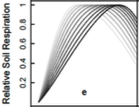

Soil Carbon Cycling
Temperature limitation:
f(T)=Q10^{((T−30)/10)}
Q10 = increase in C decomposition rate with 10°C rise in temperature (T).
Q10 often ~2 → near exponential increase in decomposition with T.
Moisture limitation: empirical functions that limit decomposition at high and low soil moisture
Dependent on soil texture
Moyano et al. (2012; 2013)
Parton et al. (1988)
Notes:
This slide shows the Temperature and water limitations on decomposition of C in various soil pools
Q10 = increase in C decomposition rate with 10°C rise in temperature (T).
Q10 often ~2 → near exponential increase in decomposition with T.
2. Moisture limitation: empirical functions that limit decomposition at high and low soil moisture
Dependent on soil texture

Slide 21
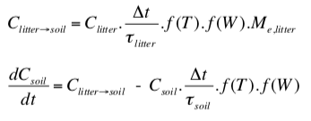
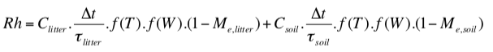
Soil Carbon Cycling – Example equations
Carbon decomposed in litter pool
Change in soil C (in one pool)
Heterotrophic respiration (CO₂ released)
First-order linear differential equations and linear dependence on environmental variables; therefore, easy to solve!
Generally tend to calculate flux and changes in C pools per daily timestep, but can solve analytically (see p307 of textbook if interested)
Notes:
Here’s the equations of C transferred from litter to soil pool in each time step, based on stuffs in previous slides
So the flow depends on the size of the litter pool itself, the residence time of litter pool, temperature and water dependency and finally the microbial activity of the litter pool
Change in soil C pool is fluxes in (from the first equation) minus the C flow to the next soil C pool
Then heterotrophic respiration is the same as the soil decomposed in the litter and soil C pool but with 1-Me for each.
These are First-order linear differential equations and have linear dependence on environmental variables; therefore, easy to solve!
Generally tend to calculate flux and changes in C pools per daily timestep, but can solve analytically (see p307 of textbook if interested)

Slide 22
Recent developments in soil C modeling*
Vertically resolved of soil C pools (especially useful for peatlands) → layers within soil
Microbial dynamics → (changes in) populations of different species of microbes and their physiology → affects decomposition rates
Methane modeling (for waterlogged soils) → methanogenic bacteria are active when soil is saturated
Litter ”priming”: rising CO₂ → more growth → more turnover; therefore a litter “priming” effect increases soil decomposition (therefore release of CO₂ back to atmosphere)
Notes:
The century type of model has abstract pools with no given depth in the soil. This is an ok assumption because there is a lot of bioturbation (reworking of soils) by worms that mixes up most non-waterlogged soils.
However, given waterlogged nature of peatlands, there is low decomposition and therefore the litter and any decomposed matter tends to build up more in layers (which allows big organic C stores to build up).
Therefore for these types of ecosystems it’s useful to have layered soil C models (for example, with depth the bulk density of the soil can change, which then changes the hydrology). Same equations apply, just per soil layer.
Also vertical C flow allows better comparison with actual measurements.
So the models actually consider vertically resolved soil C pools (especially useful for peatlands), layers within soil
Microbial dynamics is very important in this process, which indicate the changes in populations of different species of microbes and their physiology, which finally affects decomposition rates
Methane modeling is vital for waterlogged soils when methanogenic bacteria are active with saturated soil
Another concept is the Litter ”priming”: with rising CO2 plants grow more, which means more turnover; therefore a litter “priming” effect increases soil decomposition (therefore release of CO2 back to atmosphere)

Slide 23
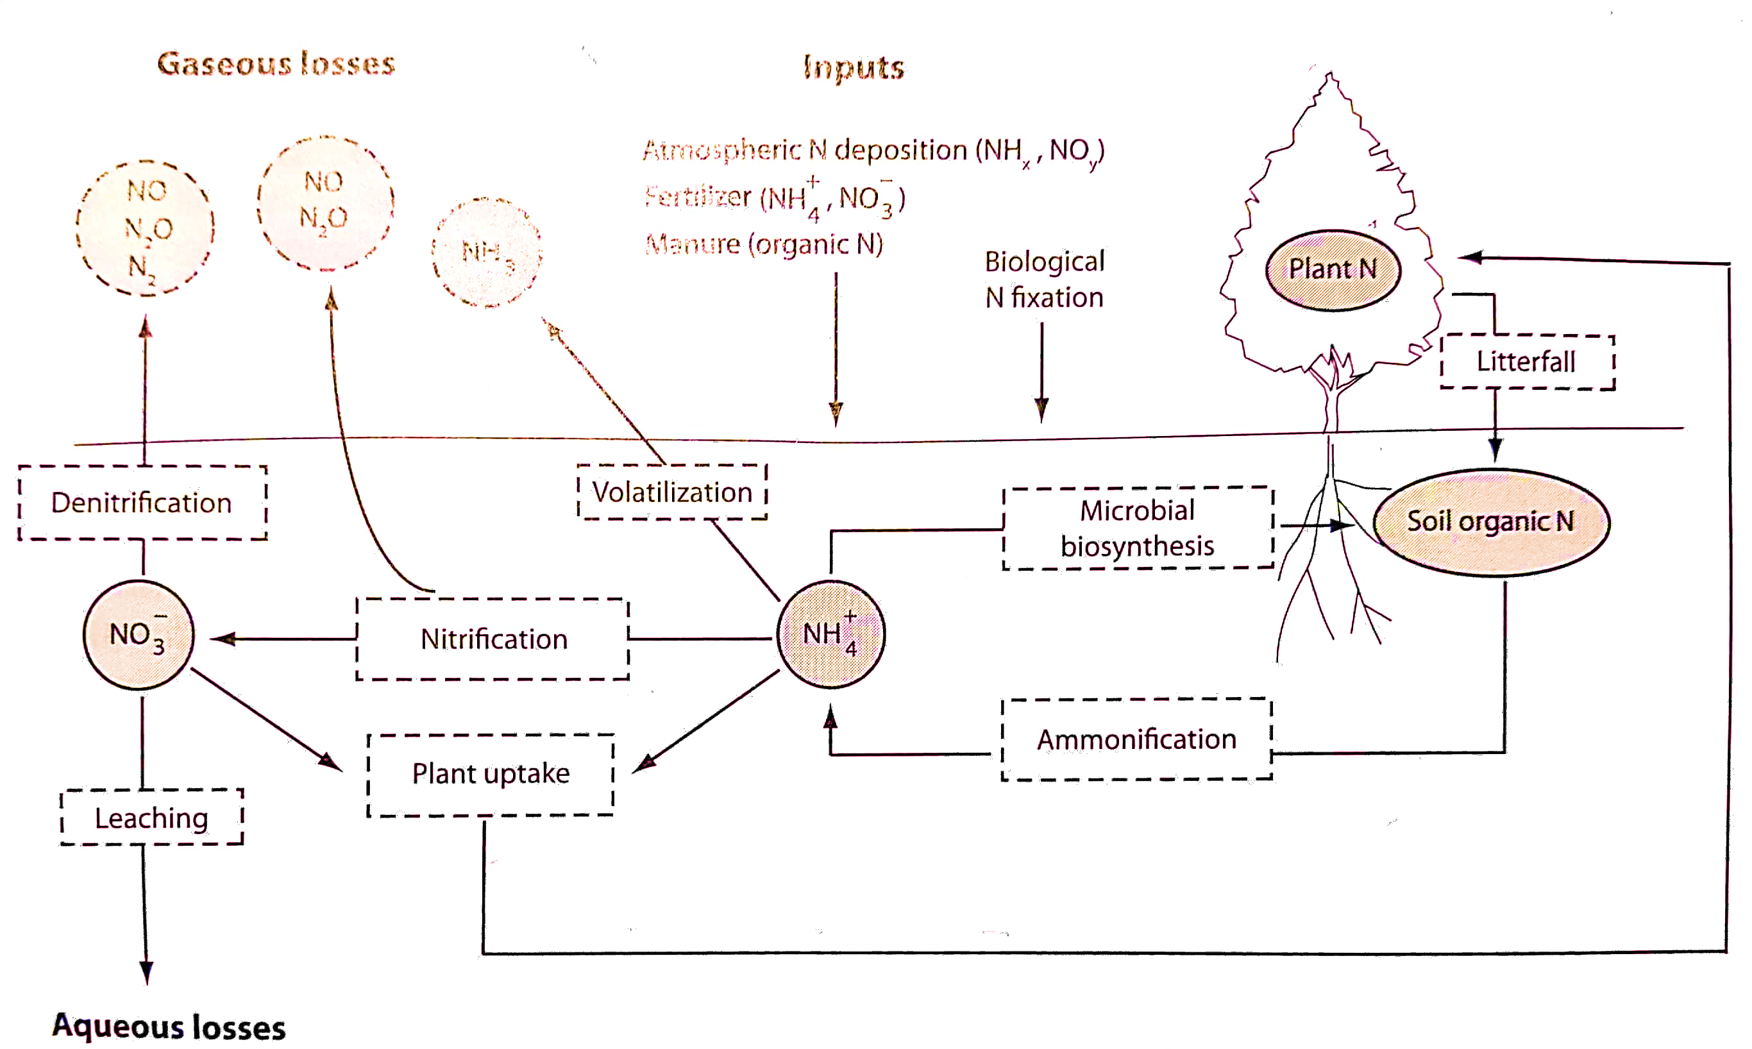
Nutrient Cycles*
Nitrogen and phosphorus availability affect all aspects of carbon cycling → can act as a limitation (or not) on photosynthesis and allocation, affect soil C decomposition (therefore, rates of respiration)
Therefore, need to know about their cycles as well → N flows parallel C
Lack of soil N may limit increased plant growth as a result of higher atmospheric CO₂
But addition of agricultural fertilizers has had big effect on C cycling in some regions
Notes:
Nitrogen and phosphorus availability affect all aspects of carbon cycling → can act as a limitation (or not) on photosynthesis and allocation, affect soil C decomposition (therefore, rates of respiration)
Therefore, need to know about their cycles as well → N flows parallel C.
The figure depicts the plant nitrogen cycle. Circles indicate various pools (solid lines) or gaseous losses (dashed lines). Boxes denotes processes.
Biological N fixation is the natural process and the anthropogenic inputs are from nitrogen deposition, fertilizers, manure.
Lack of soil N may limit increased plant growth as a result of higher atmospheric CO₂
But addition of agricultural fertilizers has had big effect on C cycling in some regions
2 models in CMIP5 (Coupled Model Inter-comparison Project Phase 5) contained the Nitrogen cycle (and they were basically the same model). Since then, the way in which the N was represented in that model has been shown to have errors.
In contrast, most models in CMIP6 will have a nitrogen cycle; therefore, it will be interesting to see if amount of carbon stored in ecosystems dramatically changes.
Some models have phosphorus now, but not yet clear if this will be included in the CMIP6 runs.
Read about N cycle on p315 of textbook

Slide 24
Disturbance*
Drought impacts: limit photosynthesis, or if severe, cause widespread tree mortality (obvious effects on C storage)
Insect outbreaks: can cause widespread defoliation (impacts C uptake)
Fire: decreases C storage (releases a lot of CO₂ to atmosphere) and affects C cycling in those ecosystems for years to come
Changes in land use/cover
Notes:
Here are few examples of disturbances: most common ones are:
First the Drought impacts: limit photosynthesis, or if severe, cause widespread tree mortality (obvious effects on C storage). If the stored C at the time of drought is good enough to support the tissue respiration, then trees might survive
Insect outbreaks: can cause widespread defoliation (impacts C uptake)
Fire: decreases C storage (releases a lot of CO₂ to atmosphere) and affects C cycling in those ecosystems for years to come
Changes in land use/cover which is the anthropogenic impact like deforestation

Slide 25
Fire models*
Original approach for C emission from fire (F_{c}) (e.g. Thonicke et al. 2001 – SPITFIRE):
F_{c} = A.∑c_{j}.f
A = forest area burned
c_{j} = carbon pool burned (leaves, stem etc. per unit forest area)
f = fraction of biomass burned and completeness of combustion (proxy for “severity” of fire)
Initial occurrence (ignition) of fire depends on weather conditions → litter moisture, fuel load (how much litter etc.)
Amount of dry fuel (over certain threshold) ignites a fire.
Recent model developments:
Fire suppression (management)
Lightning and human ignition
Vegetation adaptation to fire
Interactions between fuel structure and fire type
Notes:
I’ll briefly go through a fire model used in literature
Original approach for C emission from fire (F_{c})
Where A is the area burned; c_{j} = carbon pool burned (leaves, stem etc per unit area) and f = fraction of biomass burned and completeness of combustion (proxy for “severity” of fire)
Initial occurrence (ignition) of fire depends on weather conditions for example litter moisture, and also fuel load that is how much litter etc.
Amount of dry fuel over certain threshold actually ignites a fire
Due to recent severe fire events there has been several model developments such as:
Fire suppression (management); Lightning and human ignition; Vegetation adaptation to fire; Interactions between fuel structure and fire type etc.

